Slide 1
Contemporary Topics – 1
HR and Fraud Analytics

Slide 2
Course Outline
Session No. | Topic
Session 1: | Introduction to HR analytics
 | Prediction models for employee attrition
Session 2 | Determinants of attrition – Exploratory Factor Analysis and PCA
Session 3 | Predictive Analytics for
 | Job offer acceptance
 | Employee Selection
 | Employee Engagement
 | Performance of prediction
Session 4 | Fraud analytics
 | Default in Housing loans
 | Health insurance Fraud
 | Credit card fraud
Evaluation
Final Exam | 50%
Group Project | 50%

Slide 3
HR and Analytics
The perpetual challenge in analytics is to get meaningful insights from data and use them for competitive advantage
The top priority for any organization is to obtain and retain top talent
HR leaders rely on analytics to predict high performing recruits and identify at-risk talent
Today, HR is maturing from descriptive to predictive and prescriptive
The key challenge for HR is to interpret and act on data to solve issues and effectively advise top management.
Having data is not enough. Can you use it effectively?

Slide 4
HR Analytics
HR functions have often been late to adopt data and analytics.
Culture focus of HR as a discipline
Low demand for analytics approach
Too many imponderables
Many qualitative variables
The growth of analytics in HR is among the steepest
Oracle surveyed HR and Finance Executives
Davenport and Anderson, “HR moves boldly into advanced analytics with collaboration from finance”, https://explore.oracle.com/c/hr-analytics-report-?x=1DQwOR&source=:ow:o:h:mt:RC_NAMK190117P00056:ReadTheReport&intcmp=:ow:o:h:mt:RC_NAMK190117P00056:ReadTheReport&lb-mode=overlay&cmid=NAMK190117P00056

Slide 5
Type of Analytics in HR
Prescriptive | We know what we should do about what will happen
Predictive | We can determine what is likely to happen
Diagnostic | We can figure out why it has happened
Descriptive | We can determine what the data says happened
Novice | We know what questions to ask

Slide 6
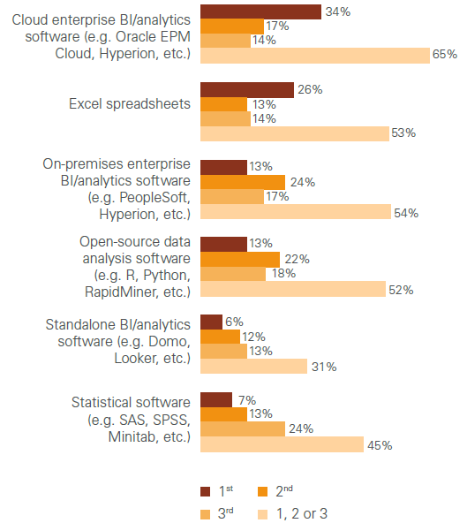
Tools Used in Analytics

Slide 7
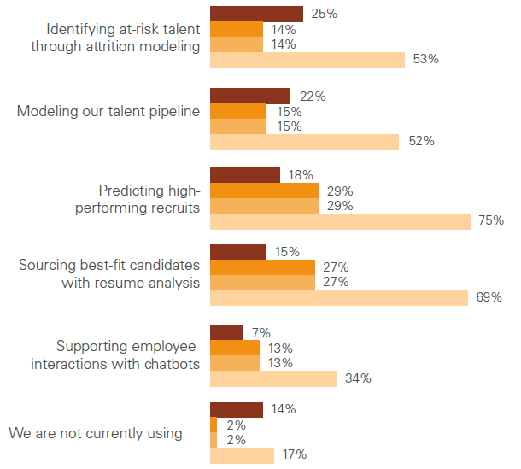
Current Use

Slide 8
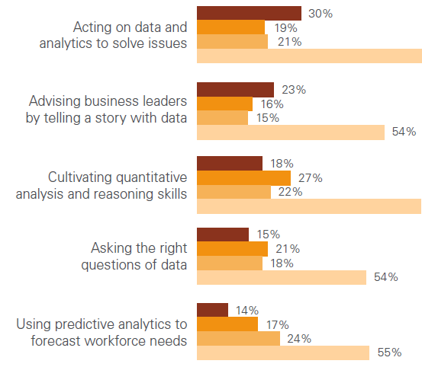
HR Analytics Skills Gap

Slide 9
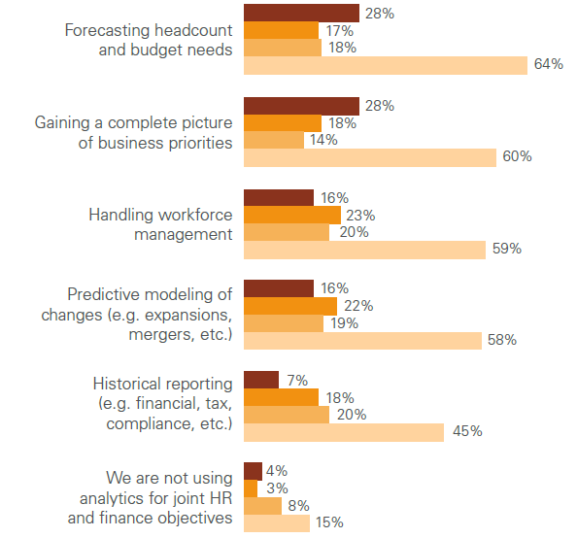
Analytics Objectives

Slide 10
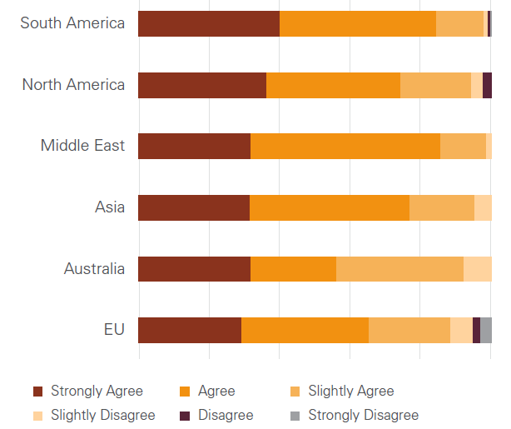
Predicting At-risk talent – next 12 months

Slide 11
Prediction of Attrition

Slide 12
Early Prediction of Employee Attrition in Software Companies
Vishnuprasad Nagadevara
Vasanthi Srinivasan
Indian Institute of Management Bangalore

Slide 13
Introduction
Employee retention is one of the biggest challenges in IT companies all over the world
Different companies adopt different strategies to retain the employees
large increases in compensation, liberal perks, frequent job rotations, Special Training, travel and stay abroad etc.

Slide 14
Literature Review
Literature on turnover indicates that a person’s intention to quit is a function of
demographic characteristics,
job characteristics and
organizational characteristics.
Individuals engage in other withdrawal behaviors like absenteeism and late-coming
We used data on demographics and the withdrawal behaviors
We applied various data mining techniques to identify turnover in organizations

Slide 15
A Model Framework on the Relationship between Attrition and Behavioural Variables
Tenure:
Total work experience
Experience in current team
Experience in current position
Withdrawal behavior:
Absenteeism
Casual leave
Privilege leave
Lateness
Arrival time at work
Job contents:
Type of position
Type domain expertise
Turnover
Frequency of job change
Demographics:
Age
Gender
Marital status

Slide 16
Objectives
To evaluate the effectiveness of different models with respect to their predictive accuracy.
To identify the factors that influence employee attrition
To develop a predictive models for employee attrition

Slide 17
Methodology
The methodology adopted involves application of various data mining techniques to predict employee attrition
The models used are
Discriminant analysis,
artificial neural networks,
logistic regression,
classification trees (C5.0),
classification and regression trees.

Slide 18
Data
The data was obtained from a software company.
The data was extracted from a sample of records
The names and other such identifiers removed (Anonymized)
Each employee record was given a unique identification number.
The sample consisted of employees who had left the company during the past 3 years as well as those who are still with the company at the time of selecting the sample.

Slide 19
Data
Gender
Marital status
Total years of work experience (3 bins)
Months of experience in the present company ( 3 Bins)
Months of experience in the current team (3 bins)
Months of experience in the current position (3 bins)
Type of position occupied in the company (6 categories)
Type of software domain expertise
Number of job changes till joining the company (3 bins)
Month-wise use of casual leave (3 bins)
Month-wise use of privilege leave (3 bins)
Month-wise data on arrival time at work (3 bins)

Slide 20
Sample Profile
28 percent had left the company
The sample is predominantly male (70%)
One-third of the sample employees were married.
Only 30 percent aged above 28 years.
The average experience (total experience) was less than 5 years.
Only 1/3 of the sample employees had more than 6 years of total experience in the industry.
The average experience within the company was slightly more than 2 years.

Slide 21
Sample Profile
More than 2/3 of the sample employees had experience of less than 30 months in the company.
18 months average experience in the current team
The average time in the current position was less than 18 months
Another interesting aspect of the sample was that the average number of job changes was just about one.
This was the very first job for about one-third of the sample employees

Slide 22
Standardized Canonical Discriminant Function (Discriminant Analysis)

Slide 23
Neural Network Model
Loyal
Age
Region
Hopper
Call Rate
Service
Lost
Income

Slide 24
Artificial Neural Networks

Slide 25
Logistic Regression

Slide 26
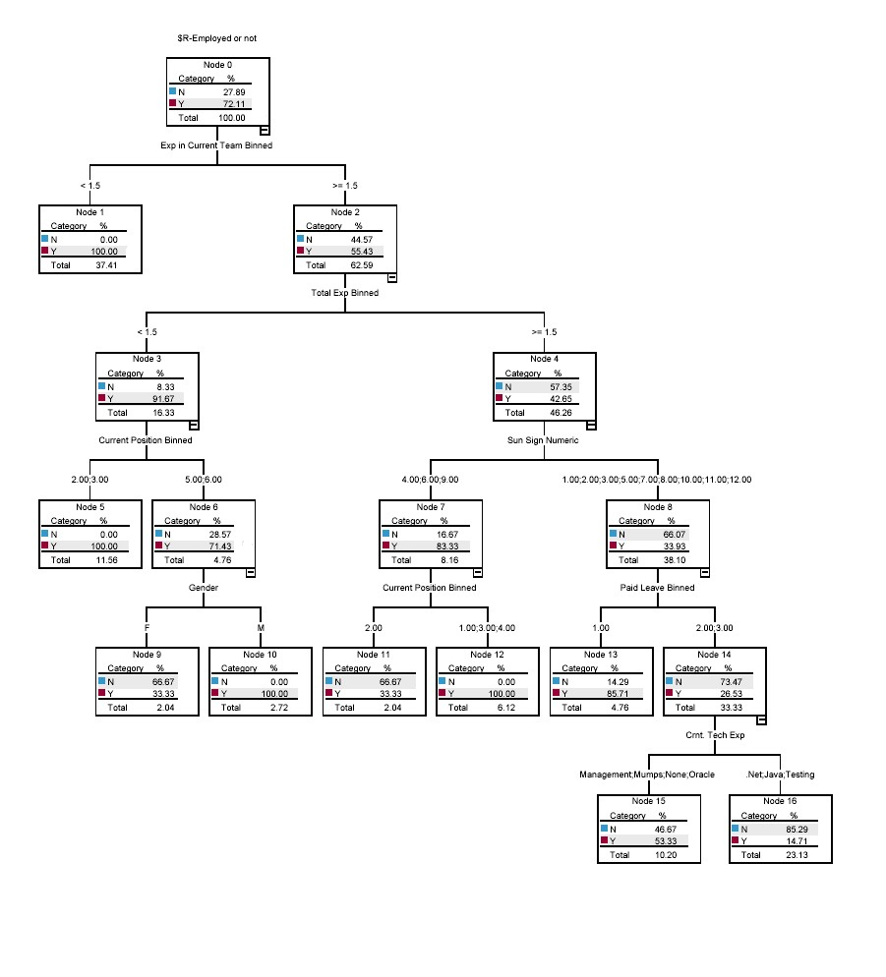
Classification and Regression Tree

Slide 27
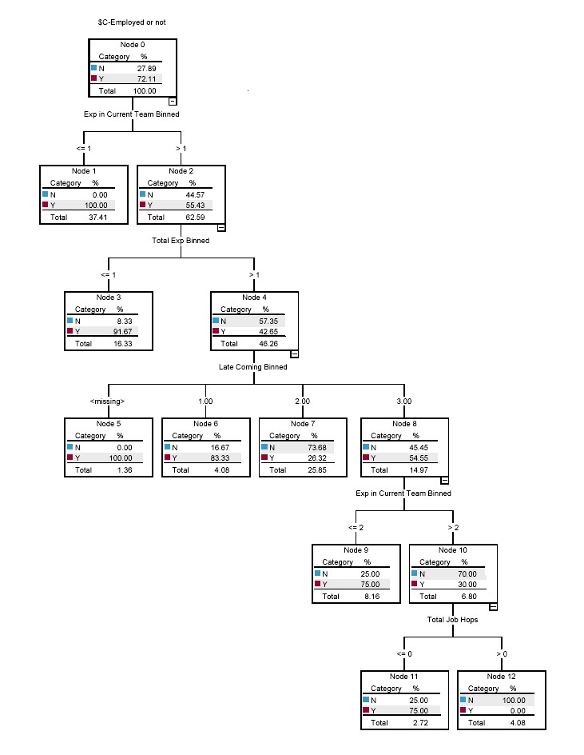
Classification Tree
C 5.0

Slide 28
Prediction Accuracy

Slide 29
Conclusions
The overall predictive accuracy was between 79.57 percent and 89.80 percent.
The prediction accuracies of those leaving have shown a wide variation on who is likely to leave
The ANNs Lowest: 58.54 percent
Discriminant analysis: Best with 86.84%
Four variables age, experience in the organization, late coming and casual leave in their relationship to turnover is significant from a research perspective.

Slide 30
Conclusions
Age is significant in the Indian context.
The IT industry has been hiring first time workforce who have unrealistic expectations
These expectations coupled with scarcity of employable skills, and soaring salaries make them particularly vulnerable for turnover.
Many employees engage in career exploration in their first few jobs.
Existing research suggests that older employees may not be able to move as easily.

Slide 31
Future Research
The role of lateness and absenteeism in predicting turnover requires further examination.
These predictions are specific to the data used
It is possible to predict the employee attrition, and identify those who are likely to leave the company even before they had made their final decision
Such predictive abilities could help the company to initiate proactive measure to minimize the attrition.
May need to adopt a hybrid methodology rather than a single technique to improve predictive accuracies.

Slide 32
PREDICTION OF EMPLOYEE ATTRITION USING WORK-PLACE RELATED VARIABLES

Slide 33
Introduction
Employee retention is one of the biggest challenges in IT companies all over the world
Different companies adopt different strategies to retain the employees
large increases in compensation, liberal perks, frequent job rotations, Special Training, travel and stay abroad etc.

Slide 34
Literature Review
Literature on turnover indicates that a person’s intention to quit is a function of
demographic characteristics,
job characteristics and
organizational characteristics.
Individuals engage in other withdrawal behaviors like absenteeism and late-coming
People used data on demographics and the withdrawal behaviors. I used Work-Place Variables
Applied various data mining techniques to identify turnover in organizations

Slide 35
Work-Place Variables
Variables which are workplace oriented were rarely used for predicting attrition
Even when these variables are used for prediction, they are usually used in combination (along with) the demographic and behavioral variables.
This paper attempts to build prediction models using workplace related variables.
The demographic and behavioral variables are intentionally kept out the models in order to evaluate the effectiveness of these variables in prediction.

Slide 36
Objectives
to develop a predictive models for employee attrition based on workplace related variables
to evaluate the effectiveness of different classification models based on their predictive accuracy.
to identify the influence of workplace related factors on employee attrition

Slide 37
Methodology
Data was collected from a large Information Technology Multinational company.
Employee data from seven different locations in India is used for the analysis.
Data with respect to the grade of the employee, extent of billability, source of recruitment, location and the group category was collected.
The database consisted of more than 31,000 records. In addition to these variables, additional data was also collected with respect to the attrition of the boss of the employee, if any, in the previous 12 months. to see if the attrition of boss will have an impact on the employee’s attrition.

Slide 38
Methodology
The database is divided randomly into two separate subsets namely, the training data set and testing dataset.
The training dataset consisted of 70 percent of the total records whereas the remaining records formed the testing dataset.
The prediction models were built using the training dataset. The effectiveness of these models is tested using the testing dataset.
Three different classification models namely Classification and Regression Trees, CHAID (Chi-square Automatic Interaction Detection) and Artificial Neural Networks were used for prediction.

Slide 39
Sample Profile
Sl. No. | Item | Frequency | Percentage
I | Location
1 | Bangalore | 14748 | 46.97
2 | Chennai | 6560 | 20.89
3 | Hyderabad | 3921 | 12.49
4 | Pune | 3056 | 9.73
5 | Kolkata | 1006 | 3.2
6 | Gurgaon | 814 | 2.59
7 | Others | 1297 | 4.13
II | Group Category
1 | Group 1 | 20696 | 65.91
2 | Group 2 | 7392 | 23.54
3 | Group 3 | 3314 | 10.55

Slide 40
Sample Profile
Sl. No. | Item | Frequency | Percentage
 | Billability status
1 | Billable | 21586 | 68.74
2 | Non-Billable | 1727 | 5.5
3 | Free Agent | 6263 | 19.94
4 | Service Function | 888 | 2.83
5 | Others | 938 | 2.99

Slide 41
Sample Profile
Sl. No. | Item | Frequency |  | Percentage
 | Grade Category
1 | Grade A | 2655 |  | 8.45
2 | Grade B | 1334 |  | 4.25
3 | Grade C | 5540 |  | 17.64
4 | Grade D | 21414 |  | 68.19
5 | Grade E | 459 |  | 1.46
 | Recruitment Source
1 | Direct from Campus | 14989 | 47.73
2 | From Outside Campus (Lateral) | 16413 | 52.27

Slide 42
Analysis and Results
Three different prediction models - Classification and Regression Trees, CHAID and Artificial Neural Networks were built.
The models built using the training dataset were tested on the testing dataset.
In terms of overall prediction rate, the Artificial Neural Networks (ANNs) performed best with accuracy levels of 91.5 percent on the training dataset and 91.73 percent of the testing dataset.
ANNs is as high as 93 percent with respect to those who are unlikely to attrite.
This accuracy drops to about 84 percent with respect to those who are likely to attrite.

Slide 43
70% Training Set
Classification and Regression Tree
Attrition | NO | YES
NO | 12,401 | 5,470 | 17,871 | 69.39%
YES | 1,140 | 3,057 | 4,197 | 72.84%
Overall Accuracy |  |  |  | 70.05%
CHAID
Attrition | NO | YES
NO | 16,706 | 1,165 | 17,871 | 93.48%
YES | 1,068 | 3,129 | 4,197 | 74.55%
Overall Accuracy |  |  |  | 89.88%
Artificial Neural Network
Attrition | NO | YES
NO | 16,662 | 1,209 | 17,871 | 93.23%
YES | 665 | 3,532 | 4,197 | 84.16%
Overall Accuracy |  |  |  | 91.51%

Slide 44
30% Testing Set
Classification and Regression Tree
Attrition | NO | YES
NO | 5,304 | 2,288 | 7,592 | 69.86%
YES | 466 | 1,276 | 1,742 | 73.25%
Overall Accuracy |  |  |  | 70.49%
CHAID
Attrition | NO | YES
NO | 7,121 | 471 | 7,592 | 93.80%
YES | 432 | 1,310 | 1,742 | 75.20%
Overall Accuracy |  |  |  | 90.33%
Artificial Neural Network
Attrition | NO | YES
NO | 7,100 | 492 | 7,592 | 93.52%
YES | 280 | 1,462 | 1,742 | 83.93%
Overall Accuracy |  |  |  | 91.73%

Slide 45
Analysis and Results
The prediction accuracies of both the training and testing datasets are very similar indicating the stability of the models. It also indicates that there is no over fitting of the models.
CHAID and ANN models are able to predict the attrition more accurately with respect to those who are unlikely to attrite.
CART Models are predicting those who are likely to attrite more accurately. A higher error weighting (1:5) was imposed on the Classification and Regression Tree models to make them predict the attriting group more accurately.
Predictions by ANNs are the most accurate. One of the variables that turned out to be very important in ANN models was the attrition level of the bosses of the employees.

Slide 46
Summary and Conclusions
This paper attempted to build prediction models using work-place related variables.
The models were able to predict attrition with a fairly high degree of accuracy.
The data used is from a multinational IT company and hence these results are more likely to be applicable to such companies.
The dataset used is fairly large indicating applicability across different categories of employees with varying demographic characteristics.

Slide 47
Summary and Conclusions
The fact that work-place related variables impact attrition can help the organization to evolve appropriate policies to retain employees for a longer period.
While it is difficult to create policies which will affect the demographic as well as behavioral characteristics of the employees, it is much easier to formulate policies which will impact the work-related variables or characteristics.
Thus, the findings of this study will help these companies to create appropriate work-place policies such that the employees are retained for longer periods.

Slide 48
Questions?
Clarifications?
Suggestions?

